Slide 1

Recitation 12 /////

Slide 2
Announcements
HW07 due this Thursday (11/11)
HW08 released this Friday (11/12) and due next Thursday (11/18)
How was Exam 3?

Slide 3
Topic Trivia
(True/False) In JavaFX, stages are placed within a scene.
What method from the Application class must be overriden in a JavaFX class?
What does the following code create: Rectangle rec = new Rectangle(0, 50, 75, 30)
(True/False) To create an image, you must pass a File object referencing the image file into the Image constructor.
If we wanted to display 5 UI elements with one in the center and one on each edge of that, what Pane should we use?
(True/False) Pane has concrete child classes BorderPane, FlowPane, StackPane, but not HBox and VBox.

Slide 4
Topic Trivia
(True/False) In JavaFX, stage(s) are placed within a scene.
What method from the Application class must be overriden in a JavaFX class?
What does the following code create: Rectangle rec = new Rectangle(0, 50, 75, 30)
(True/False) To create an image, you must pass a File object referencing the image file into the Image constructor.
If we wanted to display 5 UI elements with one in the center and one on each edge of that, what Pane should we use?
(True/False) Pane has concrete child classes BorderPane, FlowPane, StackPane, but not HBox and VBox.
false
start(Stage primaryStage)
A rectangle shape at position (0, 50) of width 75 and height 30
False, use String
BorderPane
False, despite the name

Slide 5
Topics
JavaFX1 : Concepts, graphics, shapes
JavaFX1.5 : Layout

Slide 6
Java FX Installation
TAs will now walk through the JavaFX installation guide available on Canvas in Modules under "JavaFX Setup Resources" for Watson-Phillips and "JavaFX Tutorials and Links" for Landry.

Slide 7
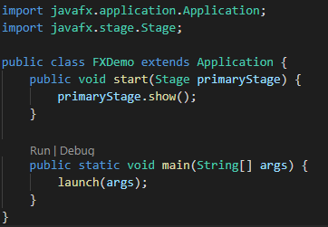
Java FX - Basics
JavaFX classes extend Application
Must override the start() method
Sets up objects in GUI
Takes in a stage object
launch() method goes in main() to create GUI
Must make imports from javafx
import javafx.application.Application;

Slide 8
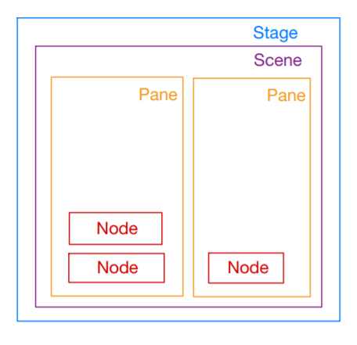
Java FX – Stages/Scenes
Stage: window which holds all other components you create
Primary stage will be passed into the start method
Scene: contains the objects for the GUI in a scene graph
Placed within the primary stage
Contains root Node
Pane: area within the scene for putting GUI Objects
Node: Visual components such as shapes, ImageView, UI controls, etc.
Each Node has its own properties (style, rotate, fill, etc.)

Slide 9
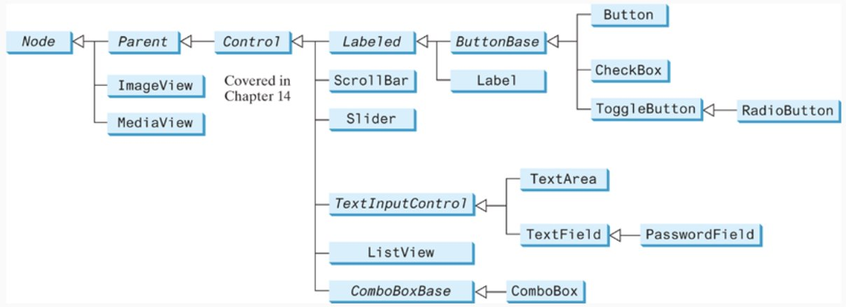
Java FX – Class Hierarchy

Slide 10
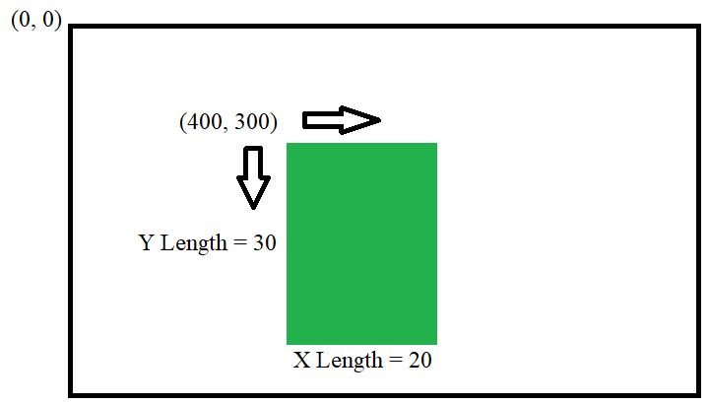
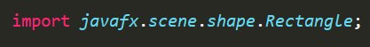
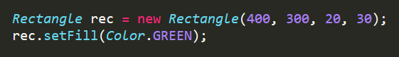
Java FX – Shapes
Subclass of Node
Abstract base class for all Shapes
Have fill, stroke, and strokewidth properties
Examples: Circle, Rectangle, Line, Arc
(x, y) = (400, 300)
X Length = 20
Y Length = 30

Slide 11
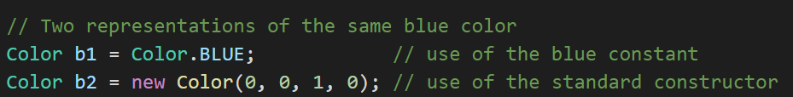
Java FX – Colors
Java class with constructor:
Color(double r, double g, double b, double opacity)
Double can be represented by a double value in the range of 0.0 - 1.0 or 0 - 255
Color class also has predefined constants
Examples: Color.RED, Color.GREEN, Color.DEEPSKYBLUE

Slide 12

Java FX – Images
Image: class that is an abstract representation of an image from a file
To show an image in the JavaFX GUI, you must create an ImageView object with the passed in Image object (similar to File & FileReader)
Example:

Slide 13
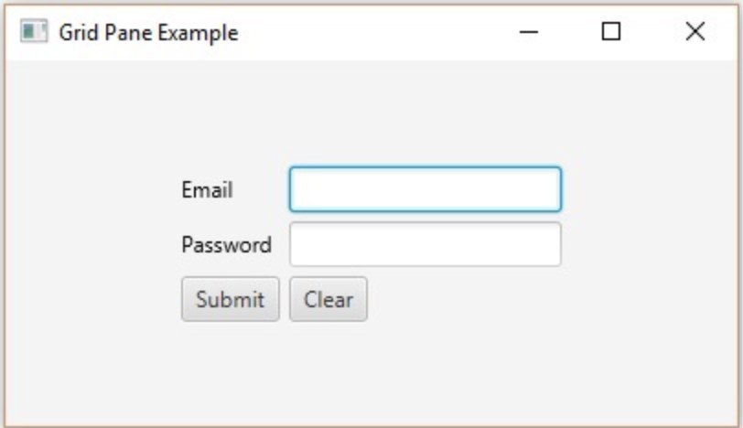
Java FX – Labels/Buttons
Label
Label: a non-editable text label with font,
direction, alignment, etc. attributes
Button: a labeled button, applications can
cause some action to occur when button
is pushed (event handling)
There are many more UI Controls (for example: TextField,
CheckBox, ToggleButton, Tab, etc.):
https://docs.oracle.com/javafx/2/ui_controls/jfxpub-ui_controls.htm
Button
TextField

Slide 14
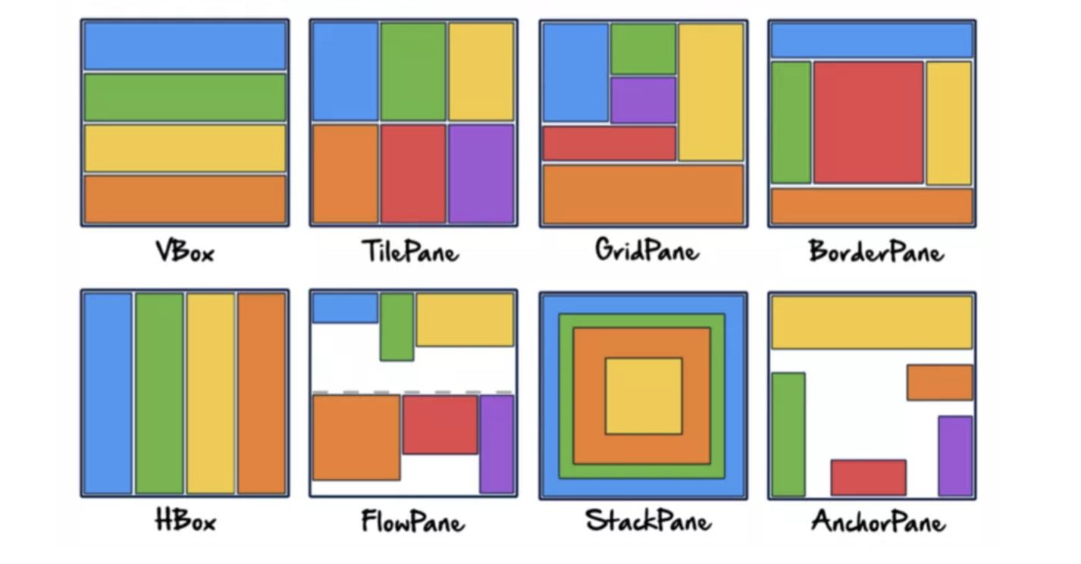
Java FX – Layout
Panes act as GUI "Managers," they control where all the components go
Pane is a base class for other layout panes: StackPane, FlowPane, GridPane, BorderPane, HBox, VBox, etc.

Slide 15
Java FX – Layout
Class | Description
Pane | Base class for layout panes. It contains the getChildren() method for returning a list of nodes in the pane
StackPane | Places the nodes on top of each other in the center of the Pane
FlowPane | Places the nodes row-by-row horizontally or column-by-column vertically
GridPane | Places the nodes in the cells in a two-dimensional grid
BorderPane | Places the nodes in the top, right, bottom, left, and center regions
HBox | Places the nodes in a single row
VBox | Places the nodes in a single column

Slide 16
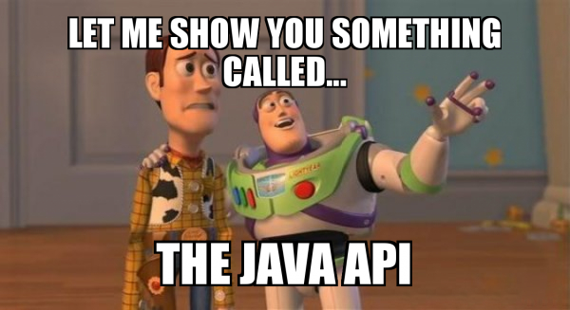
Java FX – Memorize Classes?
There are a lot, lot, lot, lot, and a lot of Java FX classes
Consult the API for all the different classes you can use and the methods associated with them
https://openjfx.io/javadoc/11/

